Slide 1


Fundamentals of RM
RM System and Process
Leadership in RM
Incident Investigation
RM Tools & Challenges
RM in Industry
People & Org.
Application and Perspectives
On Becoming a
Leader in Risk Management
ENGG404 - Lecture
Chapter 5.3:
Field Level Risk Assessment (FLRA)
Notes:
Aka FLHA

Slide 2
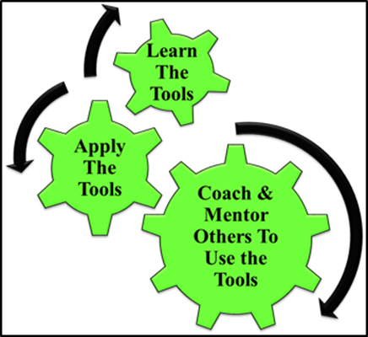
Learning Outcomes:
Explain the purpose of the Field-Level Risk Assessment (FLRA) Tool, a Risk Management tool, the manner in which it is used, and the benefits for planning work using the FLRA.
Apply this tool as a rudimentary skill of leadership to observe, interact, commend, or intervene / coach employees in the work-place.
Chapter 5.3 Field Level Risk Assessment
2
Notes:
2

Slide 3
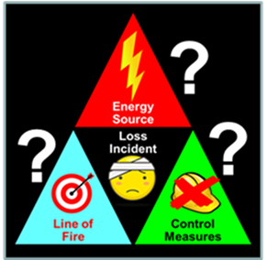
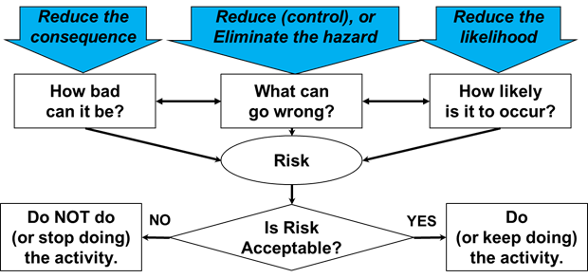
Recall … The Discovery Model & Fundamental Approach:
Our “Discovery Model” for identifying hazards asks these questions:
Find the energy sources:
Look for loss of control:
Look for the line-of-fire:
The fundamental approach for any risk assessment methodology
answers these questions:
What are you doing? (Activity)
What could go wrong? (Hazard)
How bad could it be? (Consequence)
How likely is it to happen? (Likelihood)
Is it acceptable? (Risk)
What can I do about it?
(Control Measures – Admin or Eng’g)
How does the control measure change the L and C?
(Reduce, remain unchanged, or increase?)
Chapter 5.3 Field Level Risk Assessment
3
Notes:
3

Slide 4
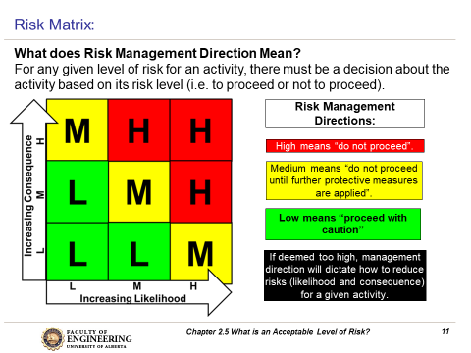
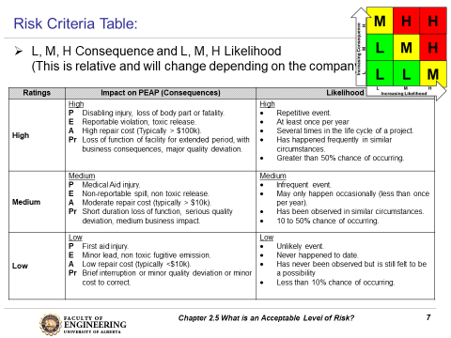
Use the Risk Matrix and Risk Criteria with the FLRA:
FIELD-LEVEL RISK ASSESSMENT
Job Step | Hazards | Risk Level Before Control Measures | Control Measures | Risk Level After Control Measures
HIGH
LOW
Chapter 5.3 Field Level Risk Assessment
4
Notes:
4
Use your risk matrix and risk criteria table

Slide 5
Purpose of an FLRA:
Key purposes of the FLRA:
It is for workers to assess hazards and to eliminate or control those hazards before starting to work (the job at hand).
It is used immediately before starting the task or job at hand; typically the team /crew /shift leader leads the workers through its use.
It is used to share and communicate the nature of the job and the hazards associated with that job when working on a crew / team / group.
It is used to ensure understanding of the control measures to eliminate or mitigate the hazards when working on a crew / team / group.
Chapter 5.3 Field Level Risk Assessment
5
Notes:
5
On the job, field level risk assessment
Requirement as a field engineer to complete one for every job (Geotech drilling, construction project, etc)
Needs to be redone every time working conditions change (weather, season, new equipment, etc)
There are no FLHAs done for tailings facilities – how do you see underground geohazards (leaking pipeline, tailings storage/dam breach)
Many hazards when working around tailings facilities – soft ground, working on water, working on ice, steam/fog, changing weather conditions, etc
Suncor tailings pond inspection – worker went out at 5am and drowned because the tailings release wasn’t obvious b/c it was below ground
Suncor was charged with not doing an FLHA, Tailings facilities don’t do FLHAs generally (not required to by law)

Slide 6
The Basic Steps to Create an FLRA:
Identify job and scope.
Determine job steps (major tasks, or tasks not anticipated in the JSA/SOP if being used).
Identify hazards associated with the job steps.
Determine risks posed by each hazard.
Identify suitable control measures for each hazard
Determine risk level after or with control measures.
Most importantly, communicate / share the FLRA with co-workers.
Implement control measures, execute / perform / do the job.
Continually re-assess risk through-out the job.
FIELD-LEVEL RISK ASSESSMENT
Job Step | Hazards | Risk Level Before Control Measures | Control Measures | Risk Level After Control Measures
HIGH
LOW
Chapter 5.3 Field Level Risk Assessment
6
Notes:
6
Similar to the general Risk management work process!
Steps listed in the handbook
Includes contractors, colleagues, etc (everyone on site)
So how can a job change? Weather, new equipment, management/personnel

Slide 7
ALE #1: Environmental Drilling Program FLRA:
Please confer and respond to
complete this FLRA
(Open discussion):
What are some control measures for each
of the hazards?
Risk Before
Risk After
1)
2)
3)
4)
5)
6)
7)
Chapter 5.3 Field Level Risk Assessment
7
Notes:
7

Slide 8
Example: Environmental Drilling Program FLRA:
Risk Before
Risk After
Chapter 5.3 Field Level Risk Assessment
8
Notes:
8

Slide 9
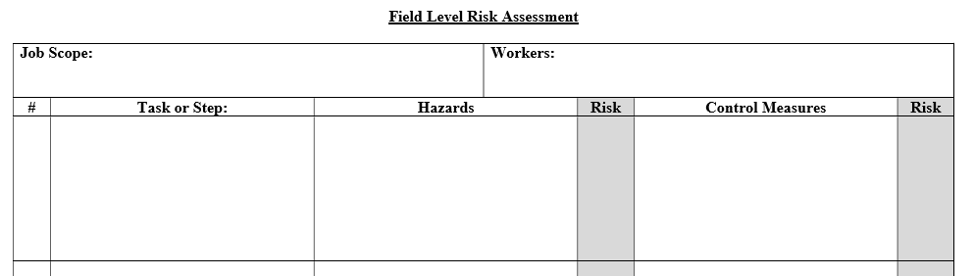
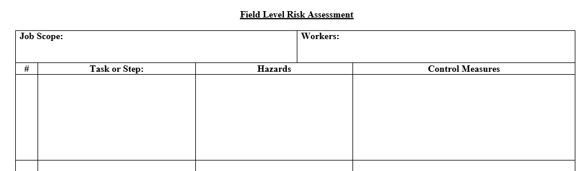
FLRA Variations:
FLRA:
Can come in different forms – all for the same purposes.
Given a commonly known task or job, you should be able to create an FLRA given the basic tools.
Chapter 5.3: Field Level Risk Assessment
9

Slide 10
FLRA as a Leadership Tool:
Apply the FLRA to reduce risks to acceptable levels, and
Coach and mentor others in its effective use.
Chapter 5.4 Semi-Quantitative Risk Assessment
10
Notes:
10

Slide 11
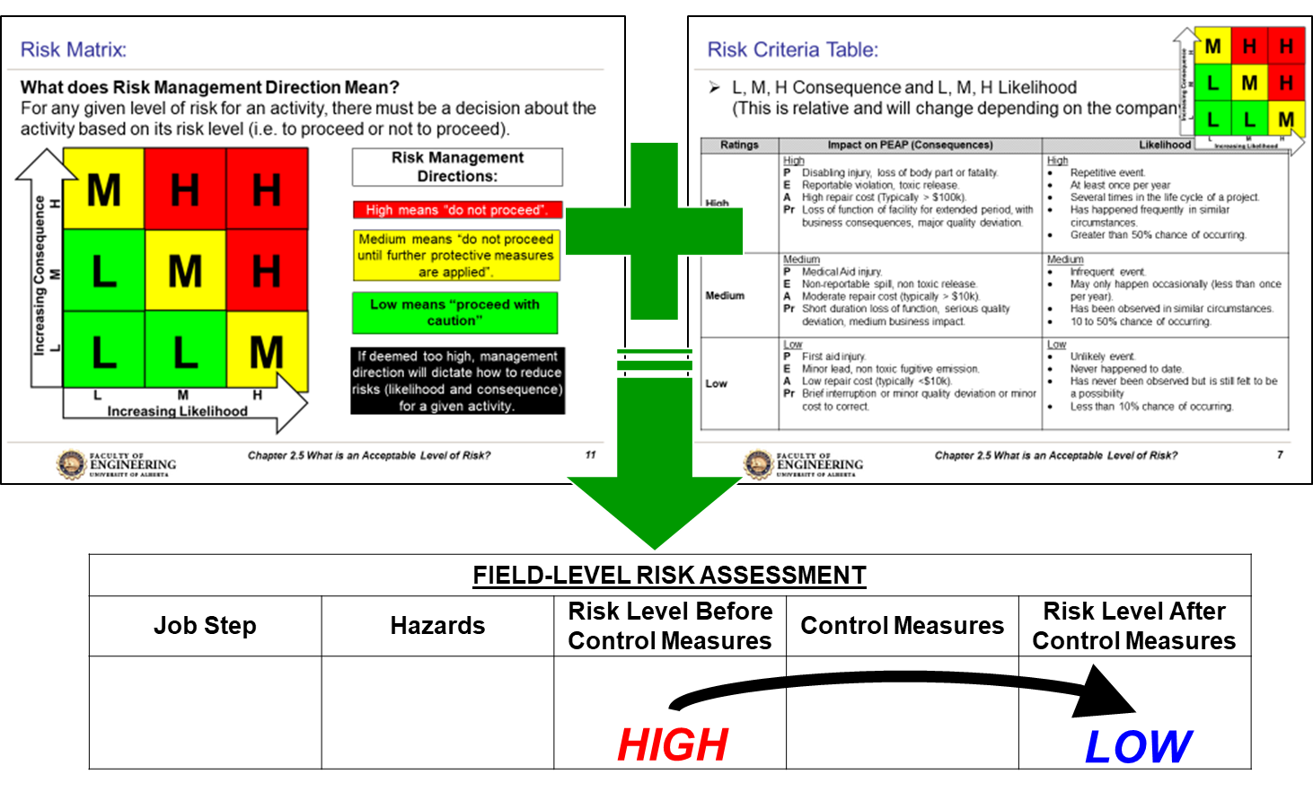

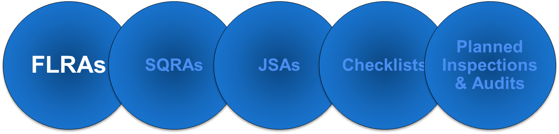
Summary and Key Lessons:
FLRA:
Used immediately prior to starting work.
One of many different risk assessment tool;
Forms come in may different formats, columns, column names, etc.
Others noted below are described in the textbook, and
Are similar in approach but have applications best suited for the job or activity!
Systematically identifies hazards associated with any activity, the risk levels, and specify the appropriate control measures.
Can be complemented with the application of incident models i.e. knowledge-based and discovery-based approaches for hazard identification.
Use your expertise to coach others!
11
Notes:
11

Slide 12
Any questions?
Notes:
12

